Slide 1
matlab作業2
B0829060黃至祥

Slide 2
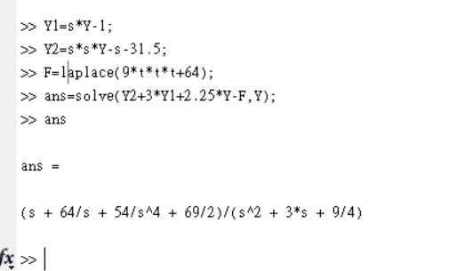

Slide 3
Y1=s*Y-1;
>> Y2=s*s*Y-s-31.5;
>> F=laplace(9*t*t*t+64);
>> ans=solve(Y2+3*Y1+2.25*Y-F,Y);
>> ans
ans =
(s + 64/s + 54/s^4 + 69/2)/(s^2 + 3*s + 9/4)

